Slide 1
The Outsiders: Teen Heroes
Kheyfets

Slide 2
Teen Heroes
Teens who support a cause or stand up for what’s right.
Who are the heroes in The Outsiders?

Slide 3
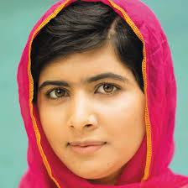
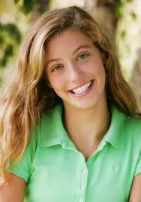
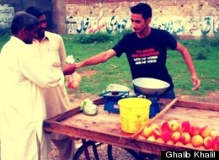
Teen Heroes
Malala Yousafzai Ghalib Khalil Talia Leman

Slide 4
Reading Organizer
Name of Activist
Main Idea
Motivation: What motivated the teen hero to take a stand and help?
Accomplishments: After he/she took a stand, how did the teen hero help, or what did the teen hero accomplish or create?
Opinion on the Article: Do you think the teen hero did the right thing? Why?
What social media was used?

Slide 5
Exit Ticket
What would happen if the teens were not allowed to use social media?

Slide 6
The Outsiders: Freedom of Speech on Facebook

Slide 7
Warm-Up
What is Facebook used for?

Slide 8
Freedom of Speech
First Amendment
(part of the Bill of Rights of the U.S. Constitution)
The right to express any opinions without censorship or restraint.

Slide 9
Bubble Map
Social
(3)
Entertainment
(3)
Facebook
Business
(3)
Political
(3)

Slide 10
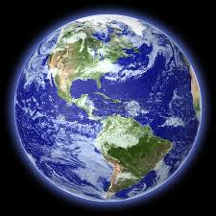
Countries that Ban Facebook
Should everybody around the world be allowed to use Facebook? Why or why not?

Slide 11
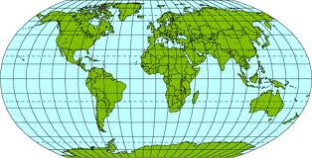
Countries that Ban Facebook
North Korea
China
Iran
Egypt
Syria

Slide 12
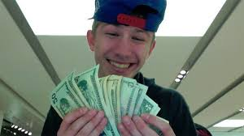
Cameron D’Ambrosio
“[Bleep] a boston bomin wait till u see the [bleep] I do, I’ma be famous rapping, and beat every murder charge that comes across me!”
What happened to D’Ambrosio after he posted this on Facebook?

Slide 13
Reflection Questions
Are you surprised this happened in the US? Why or why not?
Would you have signed the petition to free him? Why or why not?
Is having the right to free speech important? Why or why not?
Does everybody deserve the right to free spech? Why or why not?

Slide 14
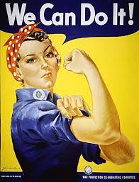
Freedom of Speech Propaganda Signs

Slide 15
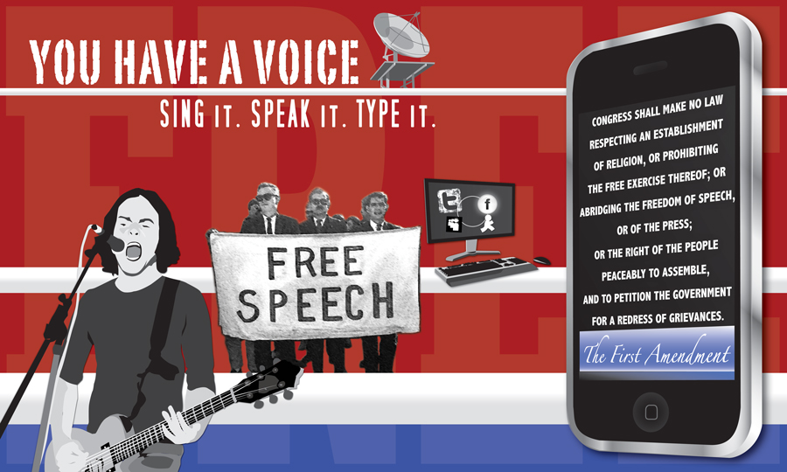

Slide 17
next day

Slide 18
Slogan Peer Review
Exchange your slogan with your partner.
Read the new slogan.
Check for spelling and punctuation.
Answer the following questions on your form:
Is the slogan easy to understand?
What is the main idea of the slogan?
Does the slogan represent the right to freedom of speech or the opposition of free speech?

Slide 19
Warm-Up
Can you post anything you want on Facebook in the US?

