Slide 1
Symbolism

Slide 2
What Symbols Stand For
A symbol is often an ordinary object, event, person, or animal to which we have attached extraordinary meaning and significance.

Slide 3
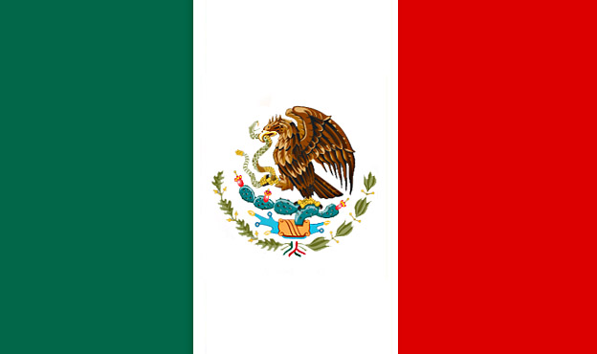
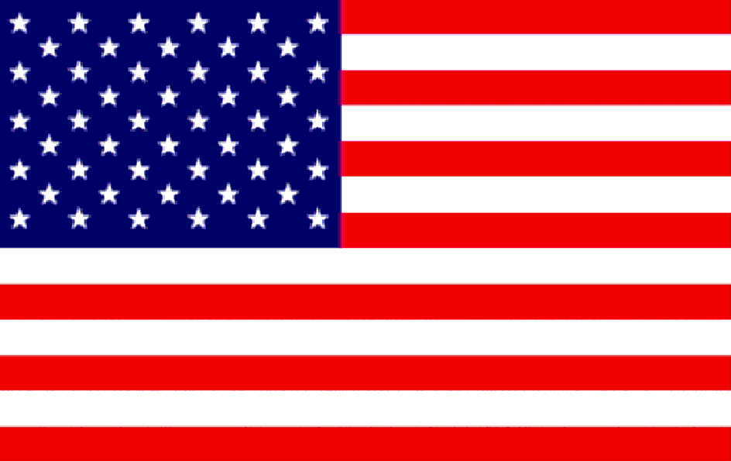
What flags symbolize…
We use a rectangle of dyed cloth to symbolize a country.

Slide 4
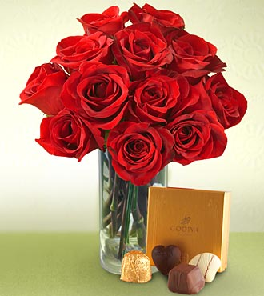
Symbols in society…
We use a picture of a skull and crossbones to symbolize poison or danger.
We send red roses as a symbol of love.

Slide 5
Where Do Symbols Come From?
Symbols can be inherited or invented
The most familiar symbols have been inherited, meaning, they have been handed down over time

Slide 6
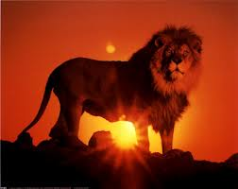
Public Symbols
For example: no one really knows who first thought of using a lion as a symbol of power, courage and domination
Once these qualities were associated with the animal, images of lions appeared on flags, banners, coats of arms and castle walls
The lion became a public symbol that shows up in art and literature, even today!

Slide 7
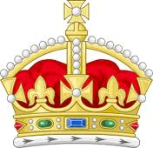
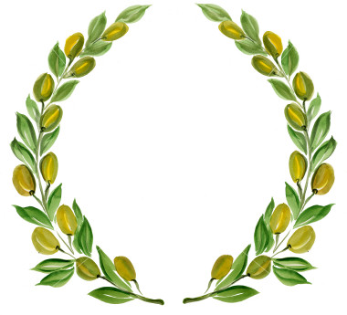
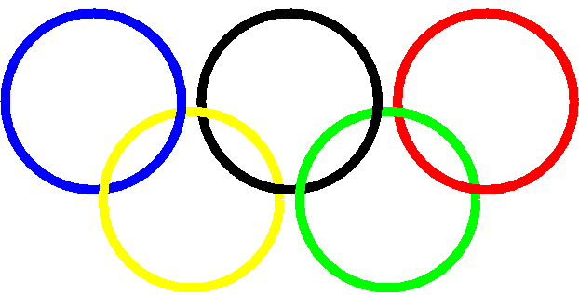
People through out history have given ordinary objects meanings far beyond their simple meaning
A crown symbolizes royalty
An olive branch symbolizes peace
Five linked rings symbolize the Olympics

Slide 8
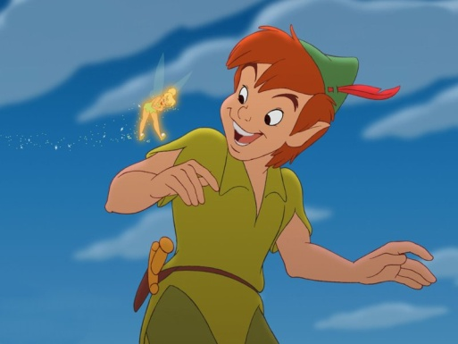
Symbols can also be invented.
What is the symbol for our
school?
Some invented symbols in literature have become so widely known that they often have gained the status of public symbols.
For example: Peter Pan is a symbol for eternal childhood

Slide 9
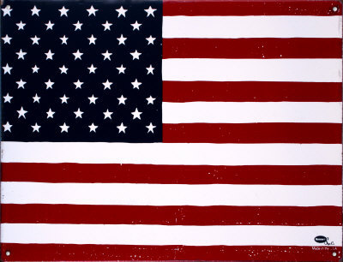

Slide 10
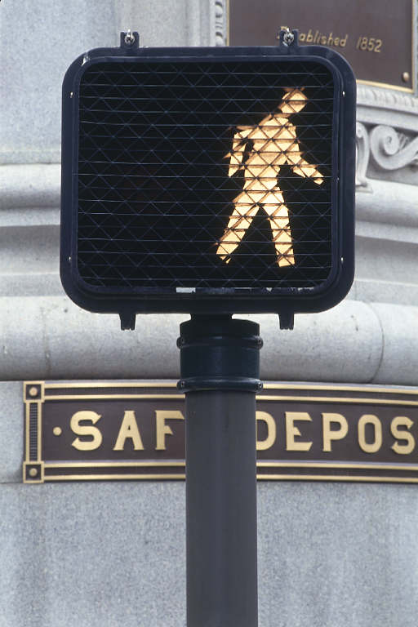

Slide 11
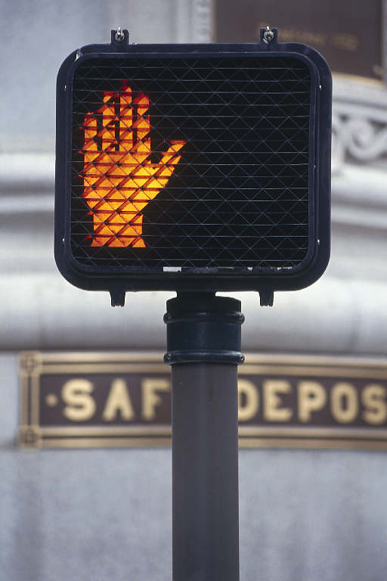

Slide 12
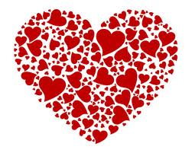
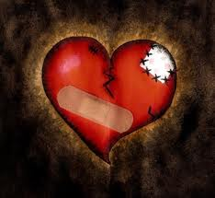

Slide 13
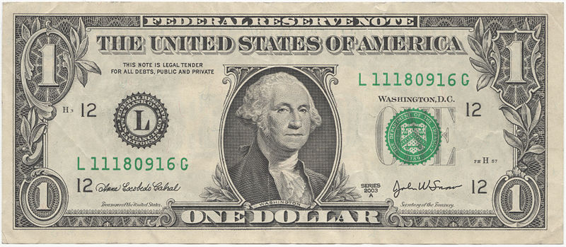

Slide 14
