Slide 1
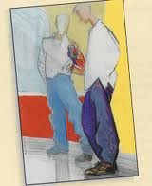
“Seventh Grade” by Gary Soto
Mrs. Kheyfets
7th grade English

Slide 2
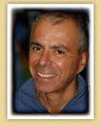
About the Author: Gary Soto
Born on April 12, 1952
Grew up in a Mexican-American community in Fresno, Ca.
Came from a working class family, when Soto was 5 years old his father died
In college he discovered poetry and writing
Soto often writes about people and experiences familiar to him

Slide 3
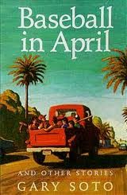
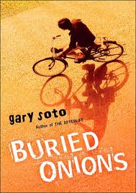
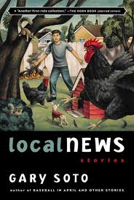
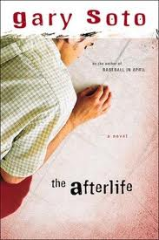
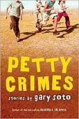
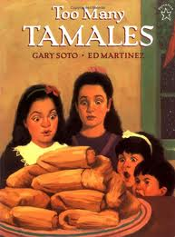
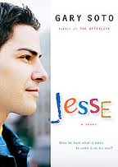
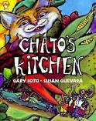
Just a few works by Gary Soto…

Slide 4
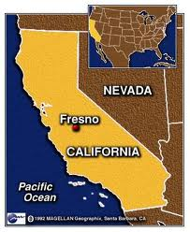
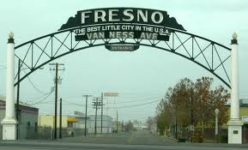
“Seventh Grade”
Short story takes place in Fresno, Ca.
Fresno is located in the San Joaquin Valley, south of San Francisco
Fresno has dry, hot summers and cool humid winters
Fresno has many vineyards (grow grapes)

Slide 5
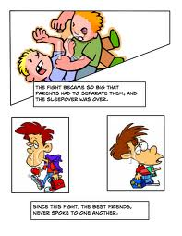
Focus for your reading…
Setting:
A story’s setting is the time and place in which events in the story occur
Objects are also part of setting because they help to paint a picture in the readers mind
Conflict:
Conflict is a struggle between opposing forces
There are 2 types of conflict, external conflict and internal conflict
External Conflict: a character struggles against another character or against some outside force
Internal Conflict: a struggle that takes place within a character

Slide 6
Making a Connection
In your journal, answer ONE of the following questions:
How do 7th graders try to impress each other?
What do you and your friends do to impress others?
Please write the question down. You will be given 7 minutes to write half a page in your notebooks.

Slide 7
Essential Questions
Identity Questions:
Who am I?
How do I form my identity?
To what extent can I control who I am?
Answer the following questions. Response must be 3 paragraphs long, one for each question.

