Slide 1
Intro to the Roman Gods
English 7
Mrs. Kheyfets

Slide 2
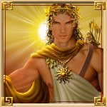
Apollo
God of the sun, light,
truth, and music
Son of Jupiter, twin brother of Diana
Amazing archer

Slide 3
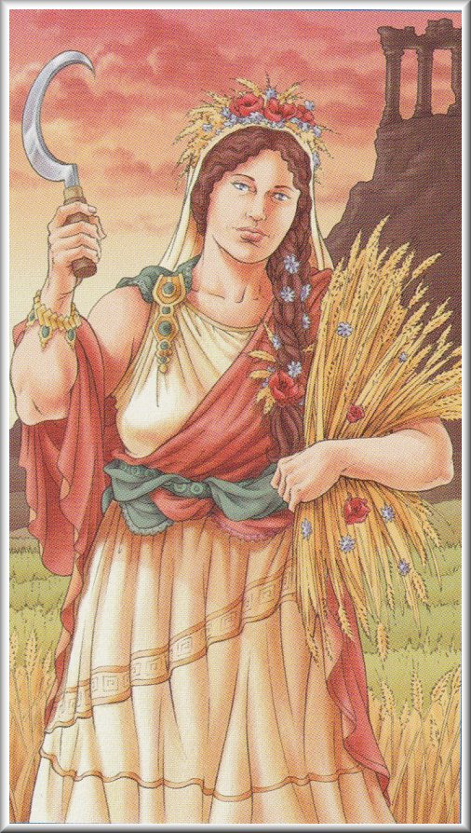
Ceres
Goddess of grain and the harvest
Sister of Jupiter
Close to nature

Slide 4
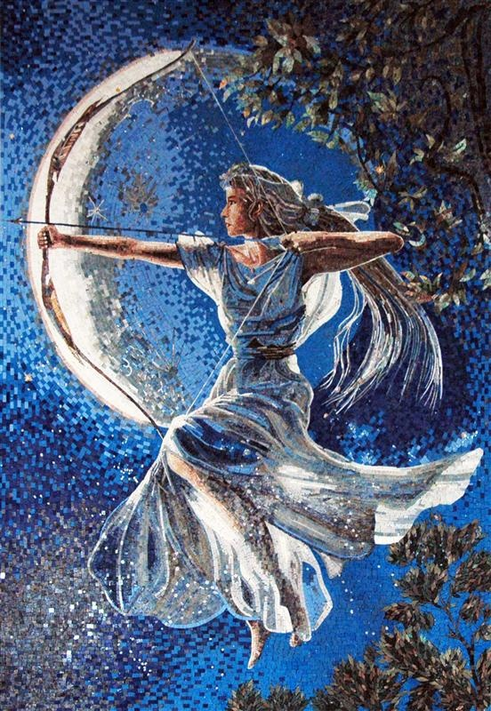
Diana
Goddess of the hunt and the moon
Daughter of Jupiter,
twin sister of Apollo
Swore to never marry
Can speak to animals

Slide 5
Juno
Queen of the gods
Goddess of marriage and mothers
Wife of Jupiter
Jealous of Jupiter’s many loves

Slide 6
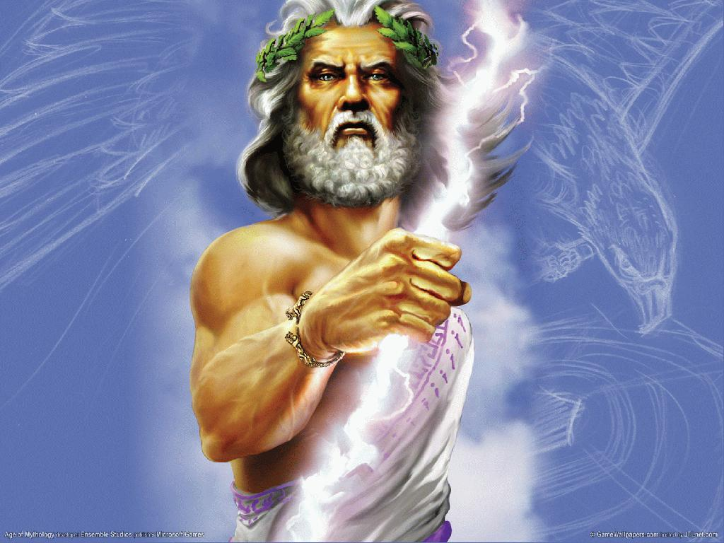
Jupiter
King of the gods
God of thunder, lightning, and storms
Husband of Juno

Slide 7
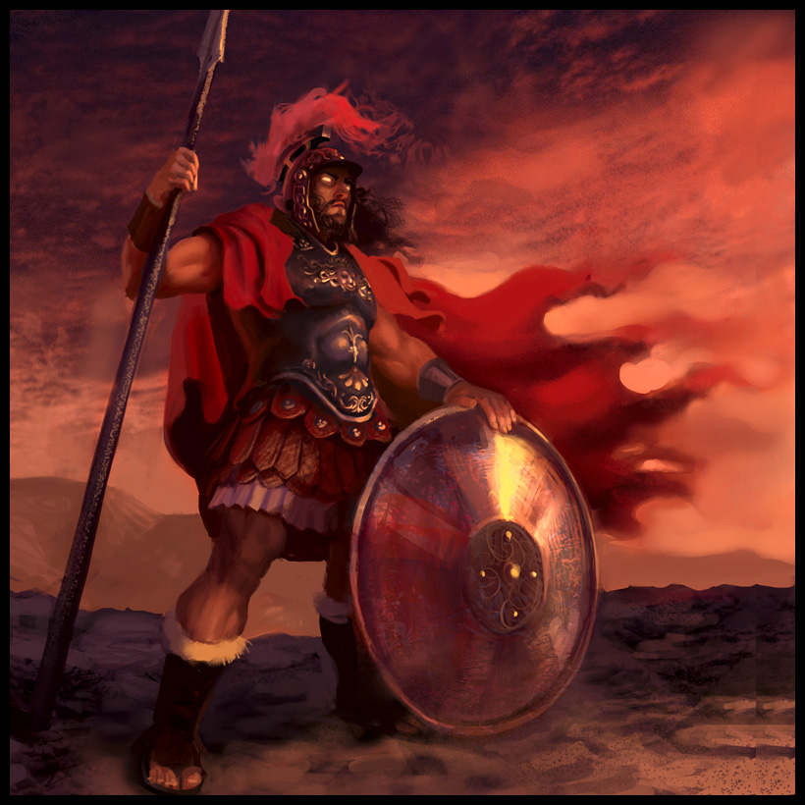
Mars
God of war
Son of Jupiter and Juno
Violent and cruel

Slide 8
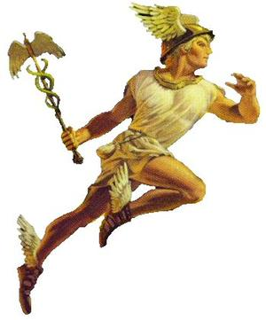
Mercury
God of travel and trade
Son of Jupiter
Fastest of the gods, flies with his winged sandals

Slide 9
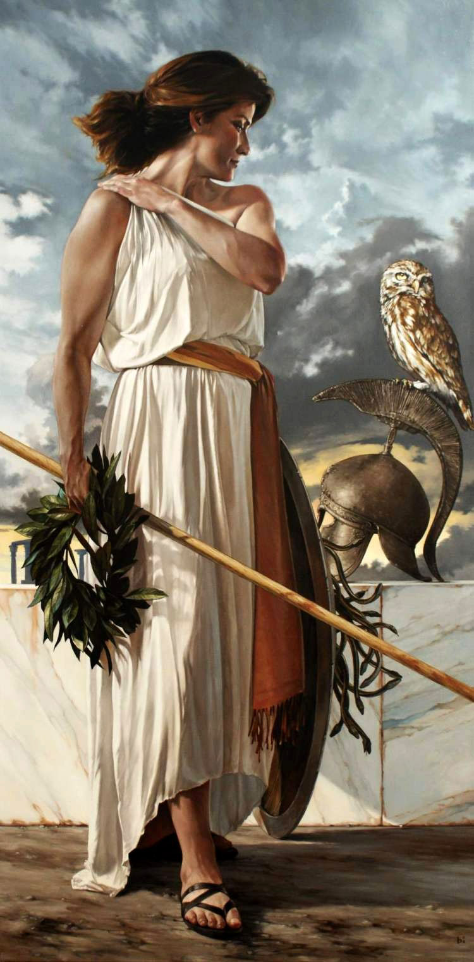
Minerva
Goddess of wisdom
Daughter of Jupiter
Intelligent and fair

Slide 10
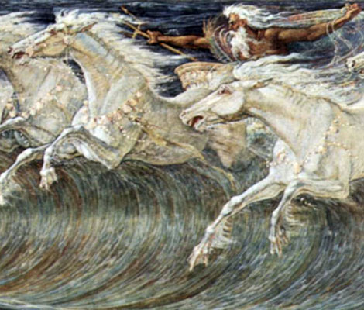
Neptune
God of the sea
Brother of Jupiter
Drives a chariot drawn by horses of the sea

Slide 11
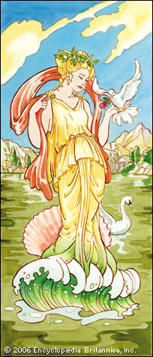
Venus
Goddess of love and beauty
Born out of the foam of the sea
Wife of Vulcan

Slide 12
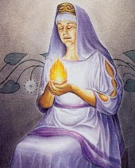
Vesta
Goddess of the hearth and home
Sister of Jupiter
Peaceful

Slide 13
Vulcan
God of fire and the forge
Son of Jupiter and Juno, husband of Venus
Born with a limp

Slide 14
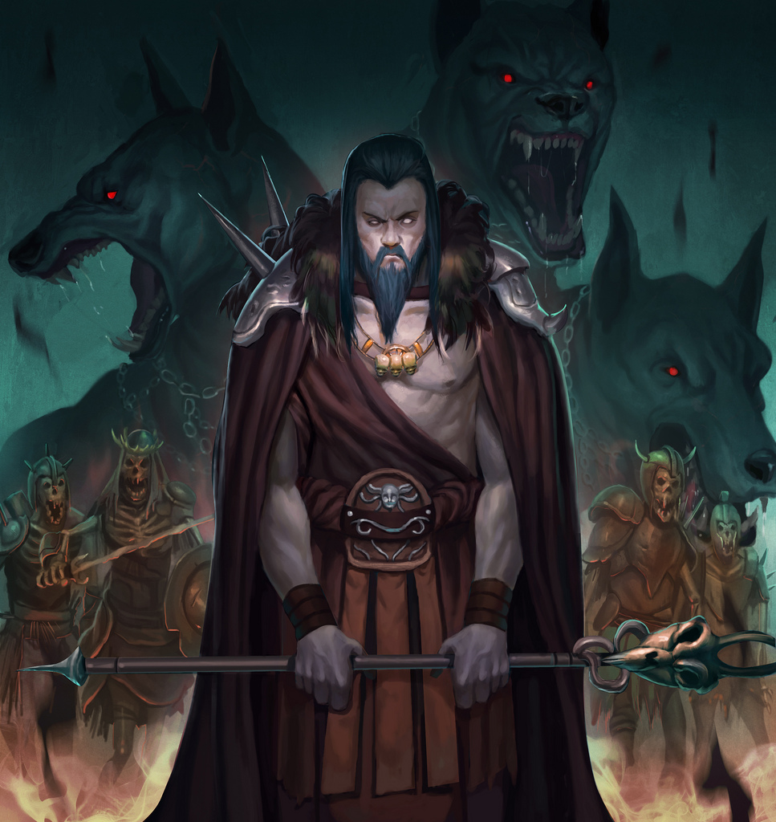
Pluto
God of the underworld
Brother of Jupiter
Gloomy and stern
Owner of the 3-headed dog Cerberus

