Slide 1
Persuasive writing

Slide 2
Persuasive Writing
An essay which tries to convince a reader to believe what you believe about a certain topic.
The writer presents a claim, provides reasons, and proves the claim with evidence.
Goal: Get the reader to agree with what the writer is arguing.

Slide 3
Stages of Writing
Prewriting (brainstorming)
Rough draft (pencil)
Revising / Editing
Final draft (typed)

Slide 4
Awesome Essay Tips
Do
Divide into 5 paragraphs
Have a thesis statement in your introduction
Come up with 3 main points to support your argument—these will be your 3 body paragraphs
Have a conclusion that contains a clincher statement
Come up with a catchy title
Don’t
Begin with “hello my name is___ and I’m going to write about____”
Take out the word I (instead of “I think we shouldn’t wear uniforms” say “Uniforms shouldn’t be required”)
Be wishy washy. Pick a side.
Forget to support your opinions with facts and example

Slide 5
A Fabulous Persuasive Essay Includes:
A terrific title
A thought provoking thesis statement
An interesting introduction with a hook
3 body paragraphs with innovative ideas
Tremendous transition words between paragraphs
A killer conclusion with a clincher statement

Slide 6
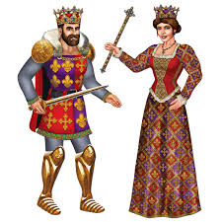
Thesis Statement
One sentence that rules your entire paper!
The controlling idea of your essay (your opinion)
It’s the last sentence of introduction
Three parts of a thesis statement:
Subject (what you are writing about)
Claim (your opinion)
Reasoning (key points to prove your claim)

Slide 7
Which one is thought provoking?
This essay describes the difference between being a student and being a scholar.
School board policy should be changed in order to implement cell phones into the curriculum.

Slide 8
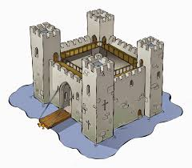
Introduction Paragraph
Structure:
Hook
Explain why hook is important
Thesis

Slide 9
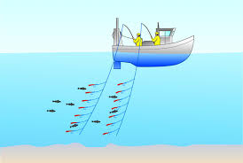
Hook
Never say “Hello….” or “This essay will be about…” BORING!
You never get a second chance to make a first impression.
You want to grab the reader’s attention!

Slide 10
Hook: Quotations
Needs to be related to Thesis
In the sentence after the quote, you need to explain why it’s important
Famous Quote
"War is nothing without a solider to fight it." - Unknown

Slide 11
3 Body Paragraphs With Innovative Ideas
Your essay needs three points to support your opinion
Each of the points will be turned into a body paragraph
Try to think of ideas that no one else would think of!

Slide 12
Body Paragraph Example: Topic
Your school has a uniform policy. Some people argue that uniforms in schools are beneficial because they cause less distractions, and some argue that they are not a good idea because they take away a student’s individuality. Do you agree or disagree with uniform policy? Make sure to support your position.

Slide 13
Body Paragraph Example: Thesis and Ideas
Thesis:
Uniform policies are beneficial in schools, and should be implemented nationwide.
Reason 1:
Allows for less bullying based on wardrobe.
Reason 2:
Students will concentrate more on school and less on attire.
Reason 3:
It cuts down on cost of school clothes and time spent getting ready in the morning.

Slide 14
Body Paragraph Structure
Topic Sentence
Concrete Detail
Commentary
Concrete Detail
Commentary
Concrete Detail
Commentary
Conclusion / Transition Sentence

Slide 15
Topic Sentence
The controlling idea for your paragraph (what the paragraph is about)
Must be covered by your thesis, relate directly to it, and support it

Slide 16
Concrete Detail
Fact, Reason, Detail, or Quote
A fact that supports the claim in your topic sentence

Slide 17
Commentary
Analysis / Explanation
Explains why you included your concrete detail within this paragraph (how CD relates to the topic sentence)

Slide 18
Transition Words
Move from one thought to the next
Usually at the beginning of body paragraphs
Avoid the same weak transition words (first, next, last)

Slide 19
Conclusion Paragraph
Restates your thesis in a different way
Gives an overview of the ideas present in your paper
Restate each topic sentence
Clincher Statement - thought to ponder
No question

Slide 20
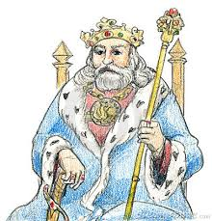
Clincher Statement
Last sentence of your essay
It should almost shock your reader
Resolves questions or claims
Settles an argument
Leaves a lasting impression

Slide 21
Conclusion Paragraph: Example
In conclusion, over 95% of parents polled are in agreement with a school wide uniform policy. Uniforms allow students to be who they are, not what they wear. After all, shouldn’t school be about academics rather than apparel? It’s time our nation got back to reading, writing, and arithmetic….not Baby Phat, Apple Bottom, and FUBU.

Slide 22
How will I be graded?
On these four areas:
Introduction
Body
Conclusion
Mechanics

