Slide 1
Outsiders Ch.3-4 Vocabulary

Slide 2
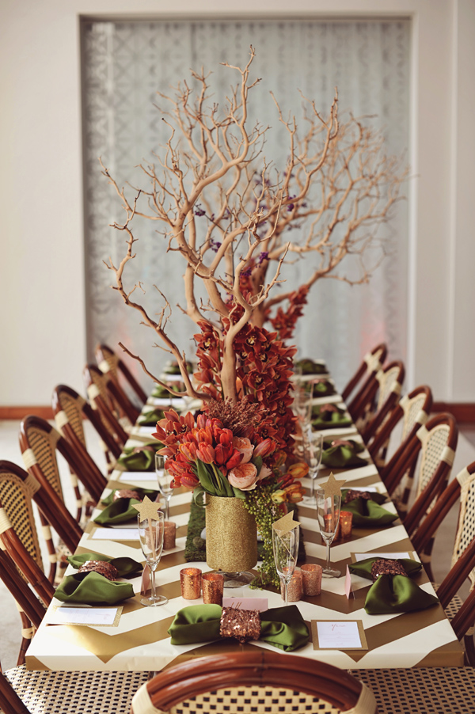
sophisticated
Part of Speech: adjective
Definition: Cultured and worldly
Example: The sophisticated gentleman welcomed guests at a dinner party.

Slide 3
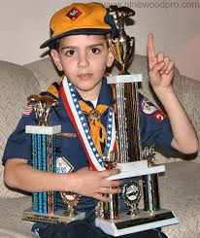
elite
Part of Speech: noun
Definition: A select body, the best
Example: The elite scouts were the only ones invited to the award ceremony.

Slide 4
resignedly
Part of Speech: adverb
Definition: Giving up, accepting the future
Example: She resignedly shook her head after she quit her job.

Slide 5
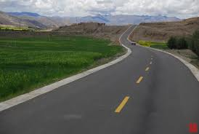
unceasingly
Part of Speech: adverb
Definition: Continual
Example: They took the road unceasingly across the country.

Slide 6
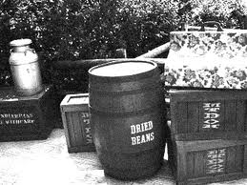
bootlegging
Part of Speech: verb
Definition: Selling alcohol where not legally available
Example: He was arrested for bootlegging.

Slide 7
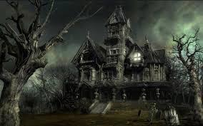
apprehensive
Part of Speech: adjective
Definition: Afraid, suspicious
Example: They were apprehensive before they entered a haunted house.

Slide 8
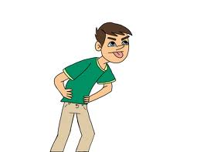
contemptuously
Part of Speech: adverb
Definition: Scornful, insolent (showing disrespect)
Example: He contemptuously made comments about the team’s loss in the finals.

Slide 9
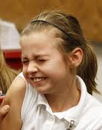
winced
Part of Speech: verb
Definition: To shrink back as from pain
Example: She winced when she hit her arm.

Slide 10
bewildering
Part of Speech: verb
Definition: Confused, perplexed
Example: She had to ask someone for directions because the map was bewildering.

Slide 11
premonition
Part of Speech: noun
Definition: Previous warning, feeling
Example: He had a premonition that something bad would happen today.

