Slide 1
The Outsiders Ch.1-2 Vocabulary

Slide 2
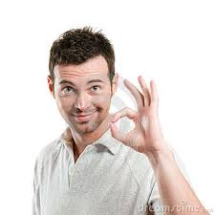
content
Part of Speech: Adjective
Definition: satisfied, pleased
Example: He was content with his score.

Slide 3
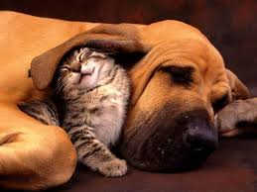
rarely
Part of Speech: Adverb
Definition: uncommon, infrequent
Example: Cats rarely get along with dogs.

Slide 4
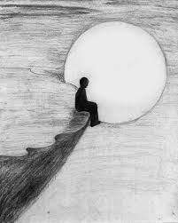
lone
Part of Speech: Adjective
Definition: by oneself
Example: The lone traveler gazed at the moon.

Slide 5
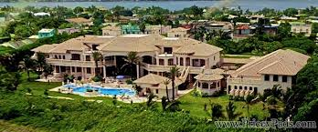
asset
Part of Speech: Noun
Definition: worth
Example: The mansion is a valuable asset.

Slide 6
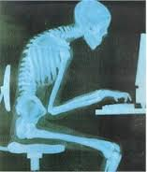
slouched
Part of Speech: Noun
Definition: an ungainly gait
Example: He slouched in front of the computer.

Slide 7
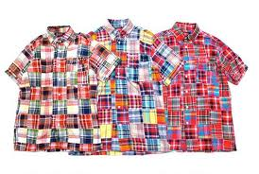
madras
Part of Speech: Noun
Definition: cotton fabric shirt, usually bright colored
Soc’s wear madras.

Slide 8
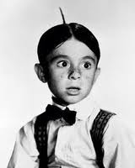
cowlick
Part of Speech: Noun
Definition: tuft of hair growing in a different direction
Example: He had a cowlick on the back of his head when he woke up.

Slide 9
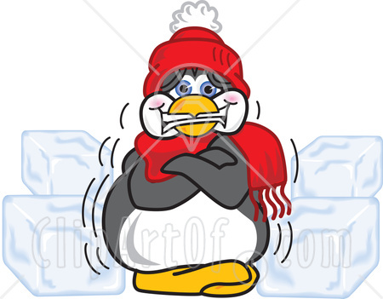
quivering
Part of Speech: Verb
Definition: trembling, shaking
Example: She was quivering when she walked into the snow.

Slide 10
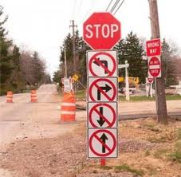
complicated
Part of Speech: Adjective
Definition: involved, complex
Example: The tourists were lost because the road signs were complicated.

Slide 11
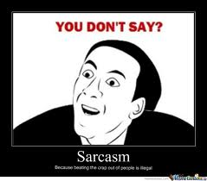
sarcasm
Part of Speech: Noun
Definition: bitter cutting jest
Example: She responded with sarcasm when they made fun of her.

Slide 12
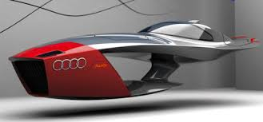
incredulous
Part of Speech: Adjective
Definition: unbelieving
Example: The idea of a flying car is incredulous.

Slide 13
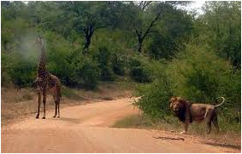
nonchalantly
Part of Speech: Adverb
Definition: indifferent
Example: He saw a giraffe nonchalantly grazing ten feet from a lion.

