Slide 1
“The Outsiders” by s.e. Hinton

Slide 2
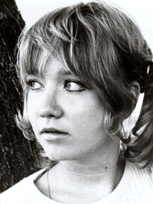
S. E. Hinton
In 1967, Viking Books published The Outsiders by a young woman named Susan Eloise Hinton.
Her novel about teens growing up in Oklahoma in 1965/1966 was a hit with young people all over the country and earned her the nickname, “The Voice of Youth.” She gave young people an author who was “one of their own,” someone who saw the world from their point of view and wrote about the real questions and fears they experienced.
(Scholastic Books)

Slide 3
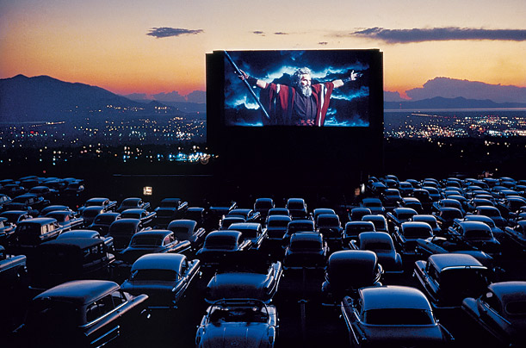
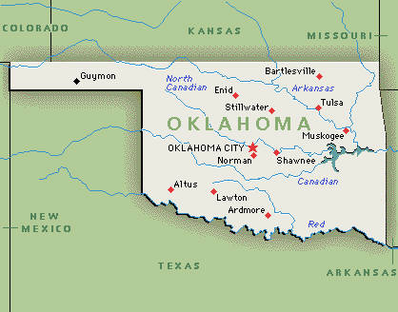
Setting
Tulsa, Oklahoma in 1965/1966
The gas stations, dreary streets, and housing of the “poor side of town” that the Greaser’s call home.
The manicured lawns of upper middle class suburbia where the Socs live.
The theaters drive-ins and burger joints that are common ground.

Slide 4
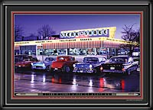
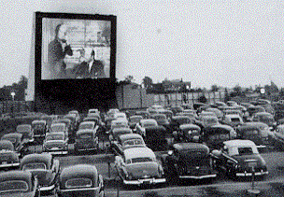
Common Ground
Drive-In Restaurants
These restaurants were a typical place to take a date. They were also where gangs hung out.
Drive-In’s
Watching movies at the drive-in
theatre was a popular thing to do,
especially for teenagers.

Slide 5
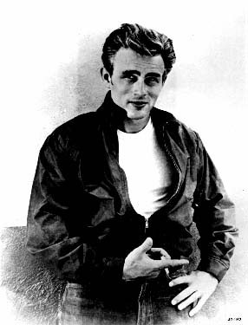
Main Characters
Greasers
Music= Elvis
Live on the East side of town
Wore leather jackets, t-shirts, jeans, and grease on their hair
Middle class working families
Socs
Music= The Beatles
Live on the West side of town
Wore madras shirts, plaid, and vests
High Social Status, rich kids

Slide 6
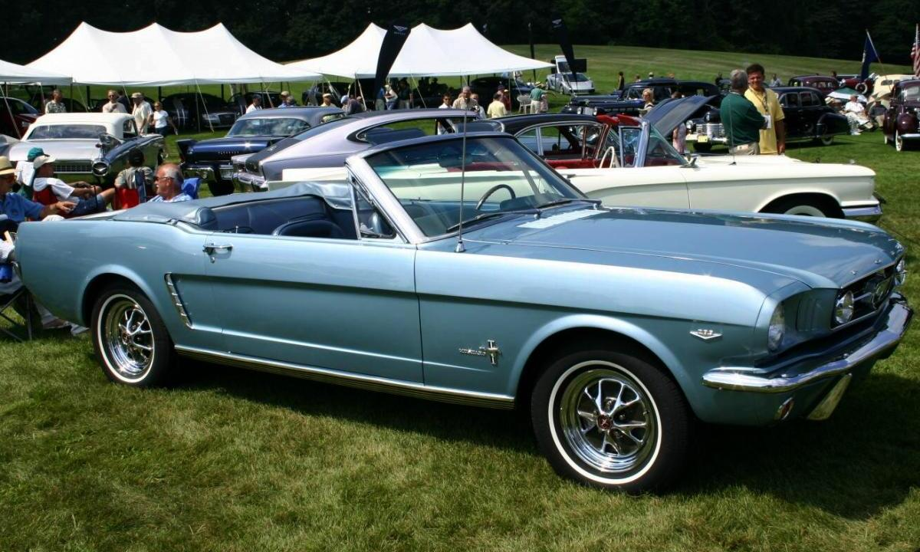
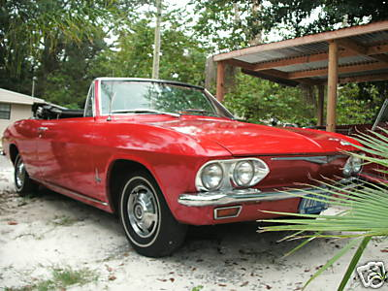
Cars used in the 1960’s
The Greasers couldn’t afford the fancy cars, but the Socs could!
Mustang and Corvair

Slide 7
Essential Question Assignment
Choose ONE of the essential questions and really think about what the question is asking.
Write the question on your sheet of paper.
Answer the question to the best of your ability.
Response must be half a page. (10 min)

Slide 8
Essential Questions
How does what we know about the world shape the way we view ourselves and society?
Why is important to recognize that all people have common life experiences that are both positive and negative?
Why is it important to judge a person as an individual rather than a member of a group?
Do you believe you are fated no matter what, or do you believe your actions can change the course of your life?

