Slide 1
Medieval Literature
Mrs.Kheyfets

Slide 2
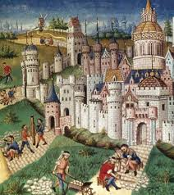
February 11, 2015: Warm-Up
List five facts about the Medieval times that you learned in History class (vocabulary counts).

Slide 3
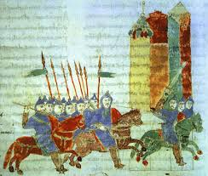
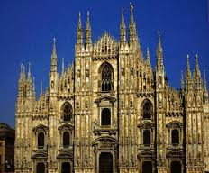
Middle Ages
500 – 1500
Oral Tradition
entertainment
Royal Courts
Knights
Courtly Love
Peasants
Religious Feasts
Towering Cathedrals

Slide 4
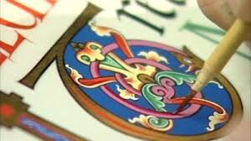
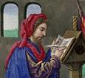
Manuscripts
Books in the Middle Ages
Pages made from Parchment
Parchment made from animal skin (sheep, cows, goats)
Scribes
Wrote manuscripts by hand
No two books were the same
Used quill pens to write
Scribes were originally monks
Illuminators
People who painted and decorated manuscripts

Slide 5
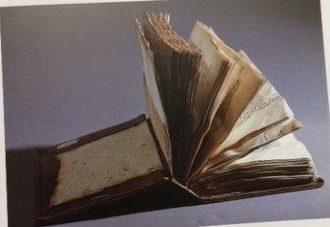
Bound Manuscript

Slide 6
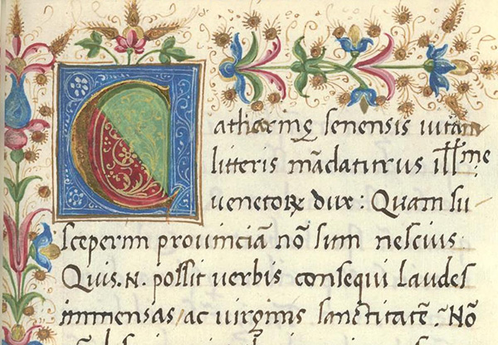

Slide 7
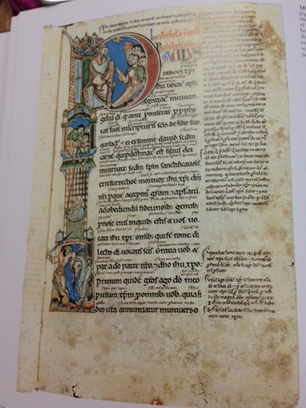

Slide 8
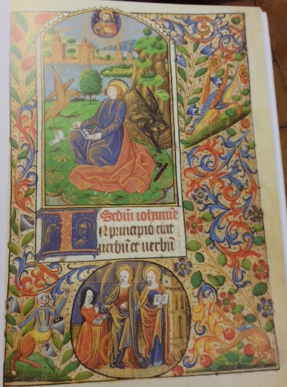

Slide 9
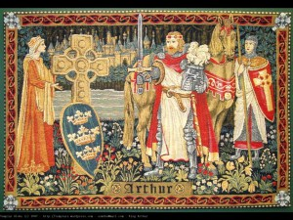
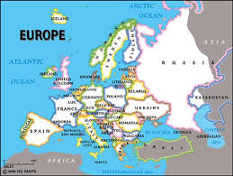
King Arthur
King of England
Ruled from Europe to Rome
Legend derives from Wales
Stories derive from the Latin chronicle of Geoffrey of Monmouth (c.1136)

Slide 10
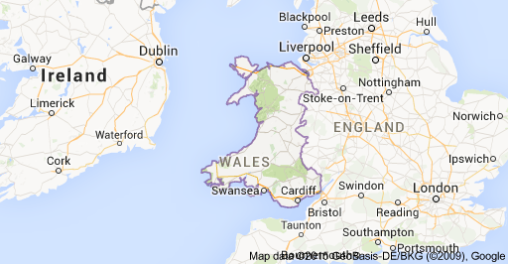
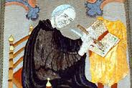
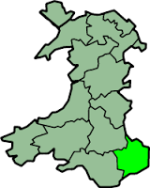
Geoffrey of Monmouth
Chronicle describes the history of the kings in the middle ages

Slide 11
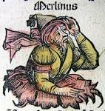
Merlin
Story of Merlin was popularized in Arthurian Romances
Geoffrey of Monmouth created Merlin
No historical evidence that Merlin existed
Wizard
King Arthur’s advisor

Slide 12
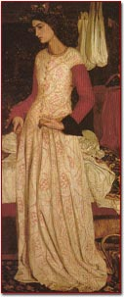
Guinevere
King Arthur’s wife

Slide 13
Rhyme Scheme
ABAB
“The people along the sand A
All turn and look one way B
They turn their back on the land A
They look at the sea all day” B
- Robert Frost
AABBCC
I do not like green eggs and ham. A
I do not like them Sam I am. A
I do not like them on a boat. B
I do not like them with a goat. B
I do not like them in a house. C
I do not like them with a mouse. C
Dr. Seuss
ABCB
Roses are red A
Violets are blue B
Dogs are cool C
And so are you B

Slide 14
February 12, 2015: Warm-Up
Could a king be a king without his own army?
Why or why not?

Slide 15
King Arthur’s Speech to Knights
https://www.youtube.com/watch?v=jWeWmpv9paw

Slide 16
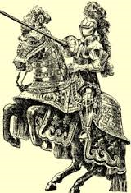
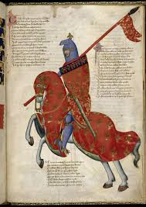
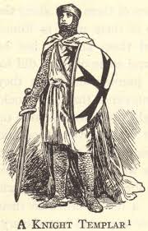
Exit Ticket
What does a Knight cherish or rely on?
(What is important to a knight?)

Slide 17
Extra Writing Prompt
“Had I been present at the Creation, I would have given some useful hints for the better ordering of the universe”
– Alfonso X, King of Castile
Based on the above quote, how does this king view himself and his role in the world?

