Slide 1
Go Figure!
Figurative Language & Literary Devices
Mrs. Kheyfets
7th grade English

Slide 2
What is figurative language?
Whenever you describe something by comparing it with something else, you are using figurative language.

Slide 3
Recognizing Figurative Language
Figurative language is not to be taken literal.
Figurative language is a writers tool
It helps the reader to visualize (see) what the writer is thinking
It puts a picture in the readers mind

Slide 4
Types of Figurative Language
Simile
Metaphor
Idioms
Alliteration
Personification
Onomatopoeia
Hyperbole

Slide 5
Simile
A simile is used to compare two things
It uses the words “like,” “as,” or “resembles” to make comparisons.
Example: The muscles on his brawny arms are strong as iron bands.

Slide 6
Metaphor
A metaphor is used to compare two things
Comparison is made without using like or as
Example: The road was a ribbon wrapped through the desert.

Slide 7
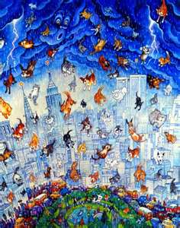
Idioms
An idiom or idiomatic expression refers to an expression in one language that cannot be matched or directly translated word-for-word in another language.
Example: It’s raining cats and dogs outside!

Slide 8
Alliteration
Repeated consonant sounds occurring at the beginning of words or within words.
Example: She was wide-eyed and wondering while she waited for Walter to waken.

Slide 9
Personification
A figure of speech which gives the qualities of a person to an animal, an object, or an idea.
Example: “The wind yells while blowing."
The wind cannot yell. Only a living thing can yell.

Slide 10
Onomatopoeia
The use of words that mimic sounds.
Example: The firecracker made a loud ka-boom!

Slide 11
Hyperbole
An exaggerated statement used to heighten effect. It is not used to mislead the reader, but to emphasize a point.
Example: She’s said so a million times.

Slide 12
Assignment
With a partner, you are going to make a list of idioms, metaphors, similes
List at least 5 examples of each
Figurative Language
Idioms | Similes | Metaphors
1.
2.
3.
4.
5.

