Slide 1
Elements of Fiction 2015
Mrs. Kheyfets- English 7

Slide 2
Setting
Time and Place
The purposes of setting are to:
Create problems for the characters
Provide background for the events and characters
Help understand the characters and their conflicts

Slide 3
Setting: three things to Consider
2. Place
Geographical (the Earth)
Topographical (places)
Inanimate Object (plane, car, boat, etc.)
1. Time:
Past
Present
Future
Season
Time of Day

Slide 4
Setting: three things to Consider
Environment
Weather
Noise level
Mood or atmosphere
Social conditions
Writing that focuses on the speech, dress, mannerisms, customs, etc. of a particular place.

Slide 5
Plot
Literary element that describes the structure of a story.
Shows arrangement of events and actions within a story.

Slide 6
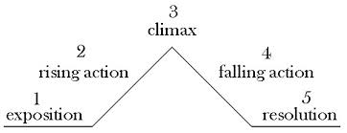
Plot
The sequence of events in a story
Built around a conflict
Tells what happens, when, and to whom

Slide 7
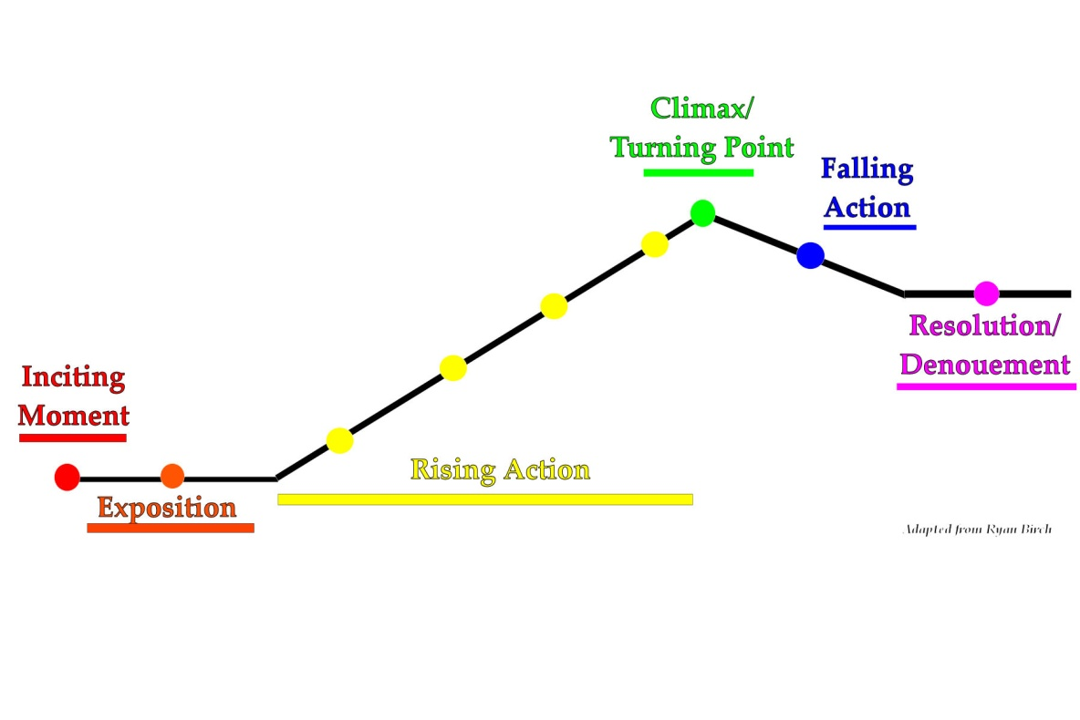
Plot

Slide 8
Plot: Exposition
Background information needed to understand the characters and the action that will take place later.

Slide 9
Plot: Rising Action
Stage in which the action builds intensity

Slide 10
Plot: Climax
Point of greatest tension or importance, where the decisive action takes place

Slide 11
Plot: Falling Action
Stage during which the intensity of the climax becomes quiet, less active, or sinks

Slide 12
Plot: Resolution
Final stage in plot where action comes to an end and loose ends are tied up

Slide 13
Conflict
The struggle between opposing forces
Internal
External

Slide 14
Internal Conflict
Person vs. Self
Problem with deciding what to do or think
Internal conflicts within
the mind of a character

Slide 15
External Conflict
Person vs. Society
Problem with the laws or beliefs of a group
Person vs. Nature
Problem with force of nature,
such as a blizzard or hurricane
Person vs. Person
Problem with another character
Person vs. Fate
Problem that seems to
be uncontrollable

Slide 16
Practice! What’s the conflict?
A hailstorm hit a small town in Georgia and caused over two million dollars in damage.
Dave and Tony began fighting over Rachel.
Susie can’t decide if she should lie to her mom about the dance or tell the truth.
Ben was going 15 miles over the speed limit when he got pulled over. He ended up getting a ticket.

Slide 17
Point of View
Narrator
The person telling the story who may or may not be a character in the story
1st Person
The narrator is a character in the story
Uses pronouns such as I, me, we, and us

Slide 18
Point of View
2nd Person
Narrator address the reader directly as though she is part of the story
(“You walk into your house. You see your dog…”)
3rd Person Limited
Narrator tells primarily what one character thinks, feels, and observes.
The narrator is not a character in the story
Uses pronouns, such as he, she, it, they, and them

Slide 19
Point of View
3rd Person Omniscient
The all-knowing narrator
The narrator relates the thoughts and feelings of all the characters
The narrator is not a character in the story
Uses pronouns, such as he, she, it, they, and them

Slide 20
Character
Person, animal, or imaginary creature
Two kinds of Characters:
Protagonist
main character or hero
Antagonist
another character who causes conflict for the protagonist.
Can be a character, society, or object

Slide 21
Characterization
A description of individuals in a story
Five ways to develop a character:
Physical description of character
Character’s speech, thought, and actions
The speech, thoughts, and actions of other characters
Eye-awakening situations
Direct statement about character

