Slide 1
Elements of Fiction
Mrs. Kheyfets

Slide 2
Plot
Plot is the literary element that describes the structure of a story.
It shows arrangement of events and actions within a story.

Slide 3
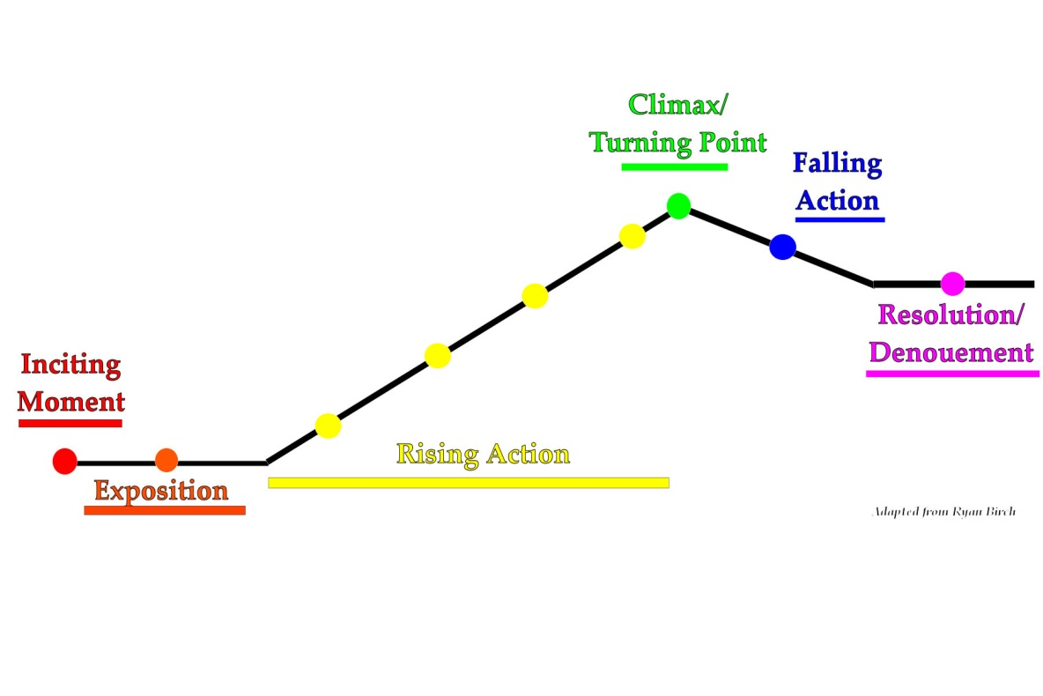
Plot
The sequence of events in a story
5 Parts of Plot:
Exposition
Rising Action
Climax
Falling Action
Resolution

Slide 4
Setting
Setting is the time and place in which a story takes place.
The purposes of setting are:
    create problems for the characters
    background for the events and characters
    to help understand the characters and their conflicts

Slide 5
3 things to consider when thinking about the Setting
1. Time
past
present
future
season
time of day
2. Place
geographical (the earth)
topographical (places)
inanimate object (plane, boat, bus, etc.)
environment

Slide 6
3 things to consider when thinking about the Setting continued
3. Environment
Weather
Noise level
Mood or atmosphere
Social conditions (writing that focuses on the speech, dress, mannerisms, customs, etc. of a particular place)

Slide 7
Point of View
Pertains to who tells the story and how it is told.
There are 5 categories:
Narrator 3rd Person Limited
1st Person 3rd Person Omniscient
2nd Person

Slide 8
Point of View
Narrator
The person telling the story who may or may not be a character in the story.
1st Person
The narrator is a character in the story
Uses pronouns, such as I, me, we, and us

Slide 9
Point of View
2nd Person
Narrator addresses the reader directly as though she is part of the story. (i.e. “You walk into your bedroom. You see clutter everywhere and…”)
3rd Person Limited
The narrator tells primarily what one character thinks, feels, and observes
The narrator is not a character in the story
Uses pronouns, such as he, she, it, they, and them

Slide 10
Point of View
3rd Person Omniscient
The all-knowing narrator
The narrator relates the thoughts and feelings of all the characters
The narrator is not a character in the story
Uses pronouns, such as he, she, it, they, and them

Slide 11
Character
A character is a person, animal, or imaginary creature
2 Kinds of Characters:
Protagonist: main character or hero
Antagonist: another character which causes conflict for the protagonist. The antagonist can be a character, society, or object.

Slide 12
Characterization
A description of individuals in a story
5 Ways to Develop a Character:
Physical Description of Character
Character’s Speech, Thought, and Actions
The Speech, Thoughts, and Actions of Other Characters
Eye-Awakening Situations
Direct Statement about Character

