Slide 1
A Child Called It: Vocab Part 1
Mrs. Kheyfets

Slide 2
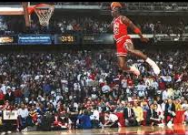
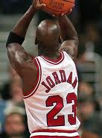
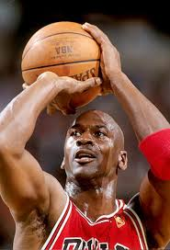
Posture
Part of Speech:
noun
Definition:
the way in which your body is positioned when you are sitting or standing
Example:
Michael Jordan has good posture on the court.

Slide 3
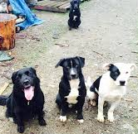
Isolated
Part of Speech:
adjective
Definition:
separate from others
Example:
The vicious dog is isolated from the pack.

Slide 4
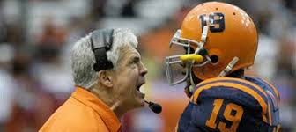
Lenient
Part of Speech:
adjective
Definition:
not strict
Example:
Instead of yelling, the coach is lenient when his team doesn’t catch the ball.

Slide 5
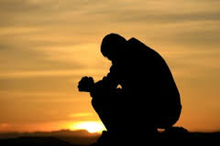
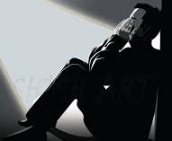
Remorse
Part of Speech:
noun
Definition:
being sorry for doing something bad in the past; a feeling of deep regret
Example:
He felt a deep remorse for having neglected his family.

Slide 6
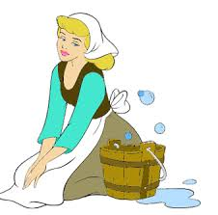
Mundane
Part of Speech:
adjective
Definition:
dull and ordinary; found in the ordinary course of events
Example:
She has a mundane routine of cleaning the floor, cooking, and doing dishes.

Slide 7
Vocab Part 2

Slide 8
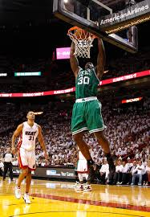
Radically
Part of Speech:
adverb
Definition:
In an extreme manner
Example:
The NBA has changed radically over the last four decades.

Slide 9
Devised
Part of Speech:
Verb
Definition:
Created, came up with
Example:
During the game, the kids devised a plan.

Slide 10
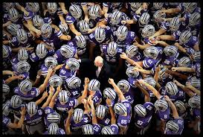
Morale
Part of Speech:
noun
Definition:
Feelings of enthusiasm and loyalty that a person or group has about a task or job
Example:
The coach tried to boost the team’s morale before the game.

Slide 11
Asset
Part of Speech:
noun
Definition:
A valuable person or thing; something that is owned by a person
Example:
Even though he is a freshman, his skills make him an asset to the varsity team.

Slide 12
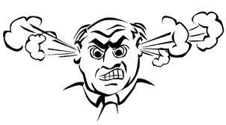
Infuriated
Part of Speech:
Verb
Definition:
Driven to extreme anger
Example:
The old man was infuriated when the boy broke his window with a baseball.

Slide 13
Vocab Part 3

Slide 14
Charade
Part of Speech:
Noun
Definition:
Acting or pretending
Example:
He looks like a tough guy, but it’s just a charade.

Slide 15
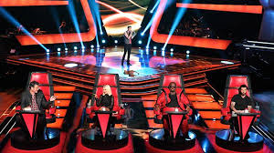
Constructive
Part of Speech:
Adjective
Definition:
Serving a useful purpose; helpful
Example:
The coach gave the singer constructive criticism on her performance.

Slide 16
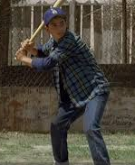
Destiny
Part of Speech:
Noun
Definition:
Events that will happen to a particular person in the future
Example:
Benny’s destiny is to become one of the greatest baseball players of all time.

Slide 17
Haven
Part of Speech:
Noun
Definition:
Safe place
Example:
Grandma’s house is his haven.

Slide 18
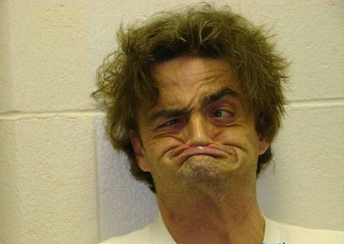
Hideous
Part of Speech:
Adjective
Definition:
Extremely ugly
Example:
The hideous man scared the children.

Slide 19
Vocab Part 4

Slide 20
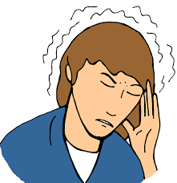
Throb
Part of Speech:
Verb
Definition:
To beat with a rapid rhythm
Example:
I have a throbbing headache.

Slide 21
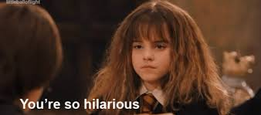
Sarcastically
Part of Speech:
Adverb
Definition:
To say something by using words that mean the opposite of what you really want to say
Example:
She sarcastically responded to the mean joke.

Slide 22
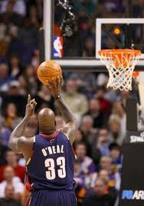
Meticulously
Part of Speech:
Adverb
Definition:
Very careful and precise
Example:
He meticulously shoots a free throw.

Slide 23
Pathetic
Part of Speech:
Adjective
Definition:
Causing feelings of sadness; Very bad, poor, weak; Deserving pity
Example:
At first, Smalls was a pathetic baseball player.

Slide 24
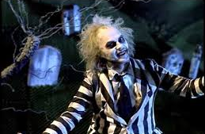
Morbid
Part of Speech:
Adjective
Definition:
Suggesting an unhealthy state of mind
Example:
He has a morbid fascination with horror films.

